Slide 1
Potato leaf diseases classification
Author
Abdelhamid Adel
Notes:
NOTE: To change images on this slide, select a picture and delete it. Then click the Insert Picture icon
in the placeholder to insert your own image.

Slide 2
Problem Statement
Farmers every year face economic loss and crop waste due to various diseases in potato plants. Early blight and Late blight are major disease of potato leaf. It is estimated that the major loss occurred in potato yield is due to these diseases. Thus the images are classified into 3 classes
Notes:
NOTE: To change images on this slide, select a picture and delete it. Then click the Insert Picture icon
in the placeholder to insert your own image.

Slide 3
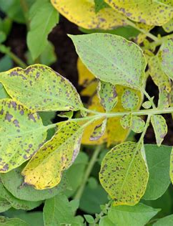
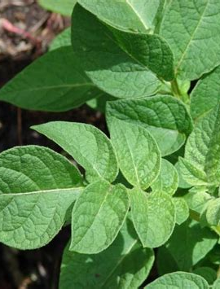
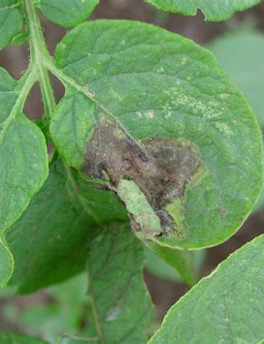
Healthy
Early Blight
Late Bligh
Notes:
NOTE: To change images on this slide, select a picture and delete it. Then click the Insert Picture icon
in the placeholder to insert your own image.

Slide 4
A quick summary of how to solve the problem
Steps :-
1- Collecting Data Process
2- Handling Data And Drop Invalid Data
3-Build Our Neural Network (CNN Model) ==> Accuracy 99 %
4-Evaluate Model ==> Accuracy 98 %
5-Build An Web App To Help Farmers To avoid those huge losses that threaten their crop

Slide 5
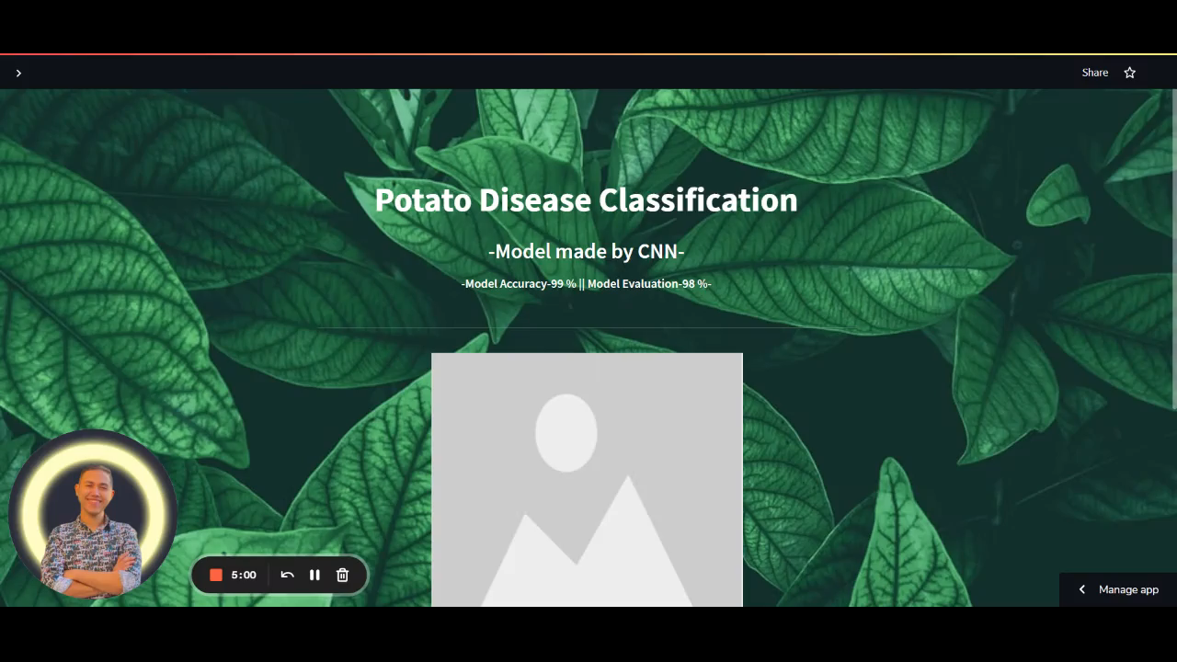
Final Product
Ctrl+Click :To Visit The Web App

Slide 6
Thank you for caring

